Slide 1
AI Lab - 10
Author: Opriță Ștefan-Simion
Contact: simionstefanoprita@gmail.com
The most profound wisdom is born from the depths of adversity, and the most beautiful roses grow from the ashes of hardship – ChatGPT

Slide 2
NLP Ambiguities
Lexical ambiguity
Syntactic ambiguity
Semantic ambiguity
Pragmatic ambiguity

Slide 3
Lexical ambiguity
A subtype of semantic ambiguity
He went to the bank.

Slide 4
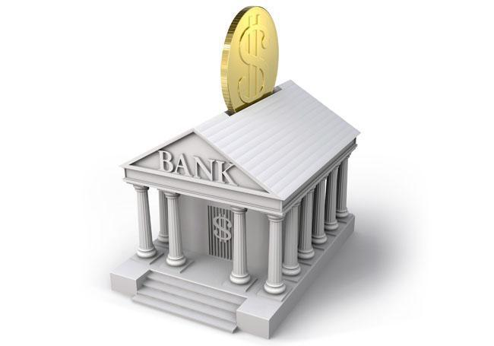
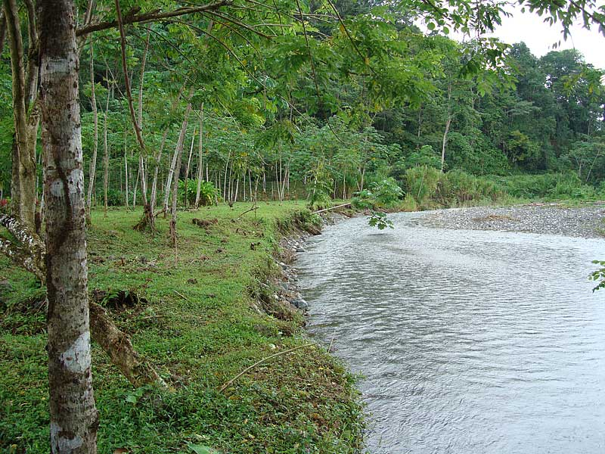
Lexical ambiguity
A subtype of semantic ambiguity
He went to the bank.

Slide 5
Semantic ambiguity
When the entire sentence can have multiple meanings due to the multiple meanings of words or how you interpret them.
The last sentence it’s an example, because we can interpret the word “bank” in two different ways.
She knew a little Greek.

Slide 6
Semantic ambiguity
She knew a little Greek.
Is it about the language or a little person that it’s Greek?

Slide 7
Syntactic Ambiguity
When the order of the words makes the whole sentence ambiguous.
John saw the man on the mountain with a telescope.
I'm glad I'm a man, and so is Lola.

Slide 8
Pragmatic Ambiguity
It’s ambiguity that arises from lack of context. Probably the hardest one to solve in NLP.
Do you know what time is it?

Slide 9
Exercise
We’ll do it in Romanian ☺
Ancheta polițistului a fost oprită.

Slide 10
Bibliography
https://docs.google.com/presentation/d/1yaszIeeZLDLiTfYbe7p6MrMJDU4l7IHKKQ8DbH74EWs/edit#slide=id.g75e35d3480_0_67
https://www.larryfike.net/philosophy/ambiguity
https://www.quora.com/What-is-pragmatic-ambiguity-in-NLP
https://www.rroij.com/open-access/ambiguities-in-natural-language-processing.pdf

